Slide 1
Chapter 8 Random-Variate Generation
Banks, Carson, Nelson & Nicol
Discrete-Event System Simulation

Slide 2
Contents
Inverse-transform Technique
Acceptance-Rejection Technique
Special Properties

Slide 3
Purpose & Overview
Develop understanding of generating samples from a specified distribution as input to a simulation model.
Illustrate some widely-used techniques for generating random variates:
Inverse-transform technique
Acceptance-rejection technique
Special properties

Slide 4
Preparation
It is assumed that a source of uniform [0,1] random numbers exists.
Linear Congruential Method (LCM)
Random numbers R, R , R , … with
f(x)
1 2
PDF
0 ≤ x ≤ 1 otherwise
f (x) = ^{⎧1}
R
⎨₀
⎩
0
F(x)
x
1
CDF
⎧0 x < 0
0 ≤ x ≤ 1
x > 1
F (x) = ⎮x
R
⎨
⎮₁
⎩
x
0
1

Slide 5
Inverse-transform Technique

Slide 6
Inverse-transform Technique
The concept:
For CDF function: r = F(x)
Generate r from uniform (0,1), a.k.a U(0,1)
Find x, x = F⁻¹(r)
F(x)
F(x)
1
1
r = F(x)
r = F(x)
r₁
r₁
r₂
x
x
x₁
x₂ x₁

Slide 7
Inverse-transform Technique
The inverse-transform technique can be used in principle for any distribution.
Most useful when the CDF F(x) has an inverse F ⁻¹(x)
which is easy to compute.
Required steps
Compute the CDF of the desired random variable X
Set F(X) = R on the range of X
Solve the equation F(X) = R for X in terms of R
Generate uniform random numbers R₁, R₂, R₃, ... and compute the desired random variate by X_{i} = F⁻¹(R_{i})

Slide 8
Inverse-transform Technique: Example
Exponential Distribution
PDF
f (x) = λe^{−λx}
CDF
F (x) = 1− e^{−λx}
To generate X₁, X₂, X₃
1− e^{−λx}=R
e^{−λx} = 1-R
− λX = ln(1− R) ; Applying Log on LHS and RHS
_{X =} ln(1− R)
− λ
Simplification
ln(R)
λ
X = F ⁻¹ (R)
X = −
Since R and (1-R) are uniformly distributed on [0,1]

Slide 9
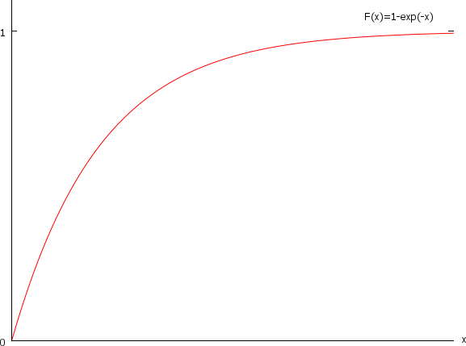
Inverse-transform Technique: Example

Slide 10
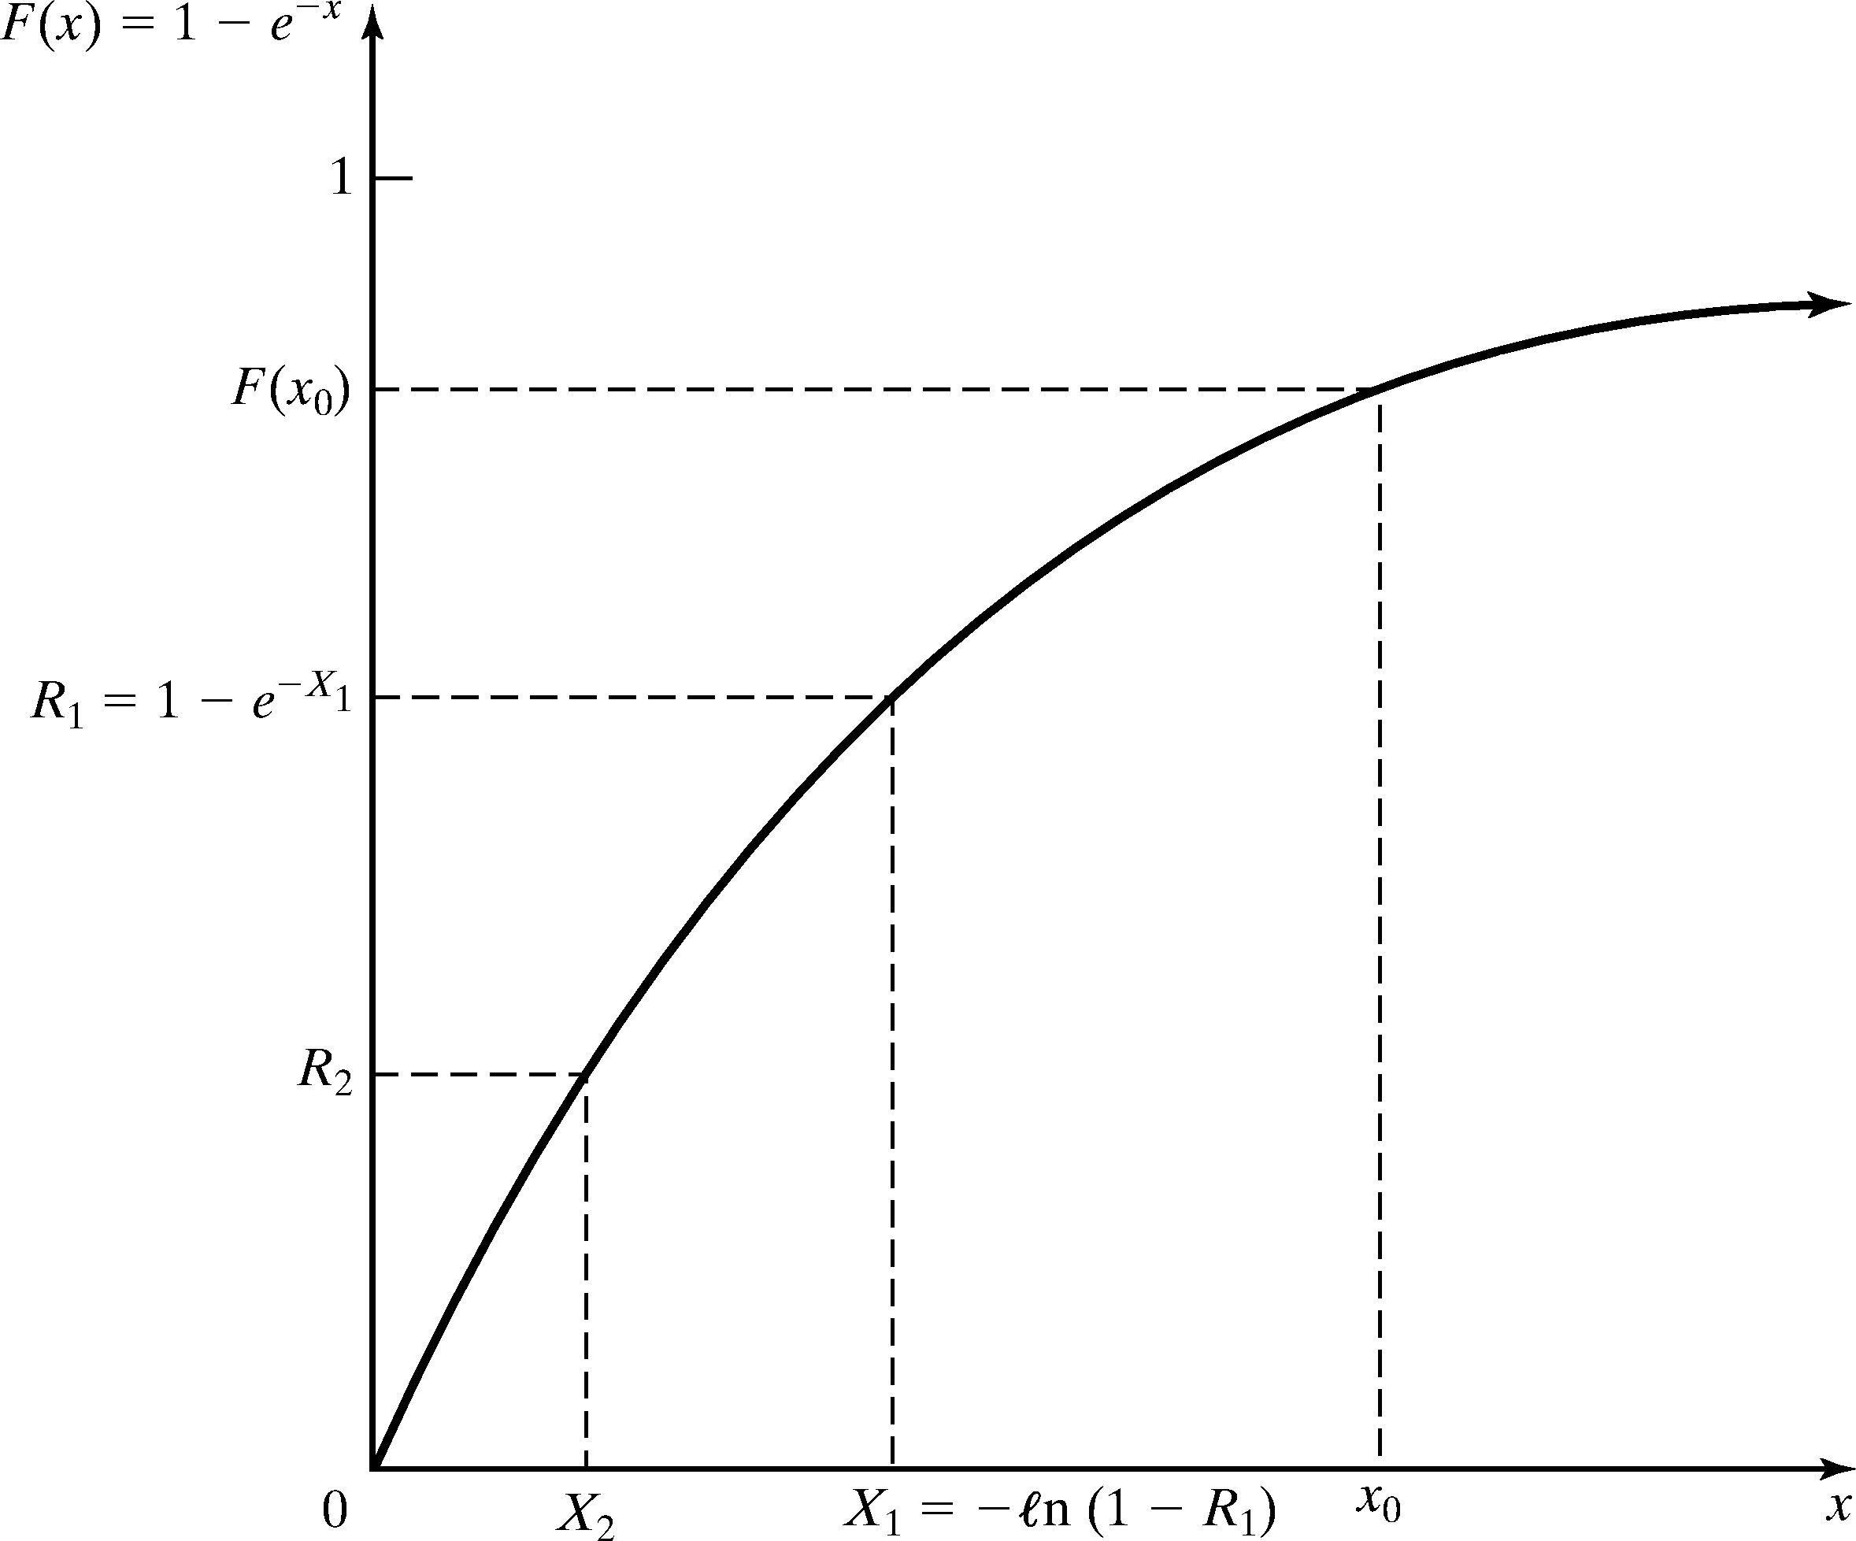
Inverse-transform Technique: Example
Inverse-transform technique for exp(λ = 1)

Slide 11




















Inverse-transform Technique: Example
Example:
Generate 200 or 500 variates X_{i} with distribution exp(λ= 1)
Generate 200 or 500 R_{s} with U(0,1), the histogram of X_{s} becomes:
0,7
0,6
0,6
0,5
0,5
0,4
0,4
0,3
0,3
0,2
0,2
0,1
0,1
0
0
0,5 1 1,5 2 2,5 3 3,5 4 4,5 5 5,5 6 6,5 7
Empirical Histogram
0,57
1,15
1,72
2,30 2,87 3,45 4,02 4,60 5,17 5,75
Rel Prob. Theor. PDF

Slide 12
Inverse-transform Technique
Check: Does the random variable X₁ have the desired distribution?
P( X₁ ≤ x₀ ) = P(R₁ ≤ F(x₀ )) = F(x₀ )

Slide 13
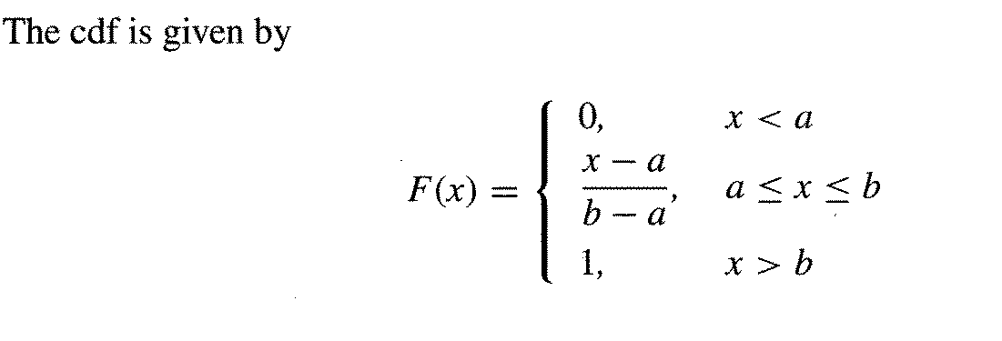
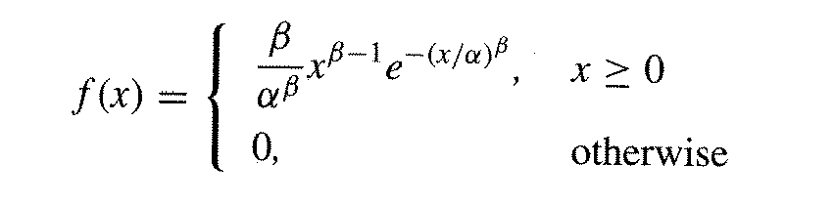
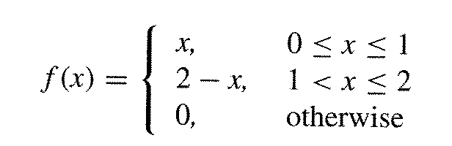
Inverse-transform Technique: Other Distributions
Examples of other distributions for which inverse CDF works are:
Uniform distribution
Weibull distribution
The pdf
Triangular distribution
The pdf

Slide 14
Other Distributions continued [Inverse-transform]
Examples of other distributions for which inverse cdf works are:
Uniform distribution
X = a + (b – a)R
Weibull distribution – time to failure
X = α[- ln(1 - R)]^{1/β}
Triangular distribution
Notes:
where r is a variate generated from Uniform (0,1)
and F-1(r) is the solution to the equation r = F(X)

Slide 15
Inverse-transform Technique: Uniform Distribution
Random variable X uniformly distributed over [a, b]
F ( X ) = R
X − a
b − a ^{= R}
X − a = R(b − a)
X = a + R(b − a)

Slide 16
Inverse-transform Technique: Weibull Distribution
The Weibull Distribution is • The variate is described by
F ( X ) = R
−( )
β
X
α
PDF
1− e = R
β
_{α} β
−( )
β
−(
)
f (x) =
β −1
x
β
x e
α
X
α
e = 1− R
− ( ) = ln(1− R)
X
α
β
CDF
_{X} β
_{α β} = −ln(1− R)
−( )
β
F(X ) = 1− e
x
α
_{X} β
= −α ^{β} ⋅ln(1− R)
X = ^{β} − α ^{β} ⋅ln(1− R)
X = α ⋅ ^{β} − ln(1− R)

Slide 17
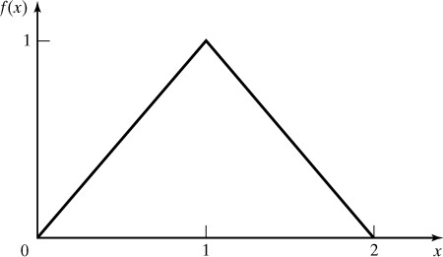
Inverse-transform Technique: Triangular Distribution
The CDF of a Triangular Distribution with endpoints (0, 2) is given by
⎧0
⎮ x²
x ≤ 0
0 < x ≤ 1
⎧
⎮
_{X} 2
⎮ ₂
0 ≤ X ≤ 1
F (x) = ⎨
R( X ) = ⎨
2
(2 − X )²
(2 − x)²
1 < x ≤ 2
x > 2
⎮1−
⎮
⎮1−
1 ≤ X ≤ 2
2
⎮⎩
2
⎮⎩1
X is generated by
⎧⎮
2R
0 ≤ R ≤ ¹
X = ⎨
2
⎮2 −
2(1− R)
¹ < R ≤ 1
⎩
2

Slide 18
Inverse-transform Technique: Empirical Continuous Distributions
When theoretical distributions are not applicable
To collect empirical data:
Resample the observed data
Interpolate between observed data points to fill in the gaps

Slide 19
Empirical Continuous Dist’n [Inverse-transform]
When theoretical distribution is not applicable
To collect empirical data:
Resample the observed data (i.e. use the data for the distribution)
Interpolate between observed data points to fill in the gaps
For a small sample set (size n):
Arrange the data from smallest to largest
Assign the probability 1/n to each interval
where
Notes:
where r is a variate generated from Uniform (0,1)
and F-1(r) is the solution to the equation r = F(X)

Slide 20
Inverse-transform Technique: Empirical Continuous Distributions
For a small sample set (size n):
Arrange the data from smallest to largest
^{x}(1) ^{≤ x} (2) ^{≤…≤ x} (n)
Set x₍₀₎=0
Assign the probability 1/n to each interval
^{x}(i-1) ^{≤ x ≤ x} (i)
i = 1,2,…, n
The slope of each line segment is defined as
x
(i) ^{− x}(i−1) ^{x}(i)
=
^{− x}(i−1)
1
a =
i
i (i −1)
_{n} −
n
n
The inverse CDF is given by
_{+ a} ⎛⎛ _{R −} (i −1) ⎞
(i −1) i
_{n} < R ≤ _{n}
X = F^{ˆ −1} (R) = x
_{i} ⎮ ⎮
when
(i−1)
⎛
n
⎠

Slide 21
Example 8.2
Five observations of fire crew response times in minutes to incoming alarms have been collected to be used in a simulation investigating possible alternative staffing and crew scheduling polices.
2.76 1.83 0.80 1.45 1.24
It is desired to develop a preliminary simulation model that uses a response – time distribution based on these five observations. Generate random variates from response

Slide 22
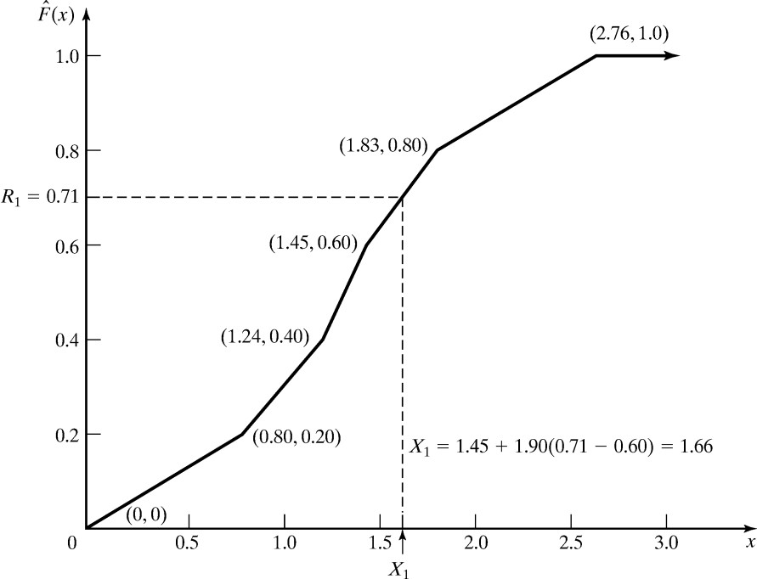
Inverse-transform Technique: Empirical Continuous Distributions
i | Interval | PDF | CDF | Slope a_{i}
1 | 0.0 < x ≤ 0.8 | 0.2 | 0.2 | 4.00
2 | 0.8 < x ≤ 1.24 | 0.2 | 0.4 | 2.20
3 | 1.24 < x ≤ 1.45 | 0.2 | 0.6 | 1.05
4 | 1.45 < x ≤ 1.83 | 0.2 | 0.8 | 1.90
5 | 1.83 < x ≤2.76 | 0.2 | 1.0 | 4.65
R₁ = 0.71
^{X}1 ^{= x}(4−1)
+ a₄ (R₁ − (4 −1) / n)
= 1.45 +1.90(0.71 − 0.6)
= 1.66

Slide 23
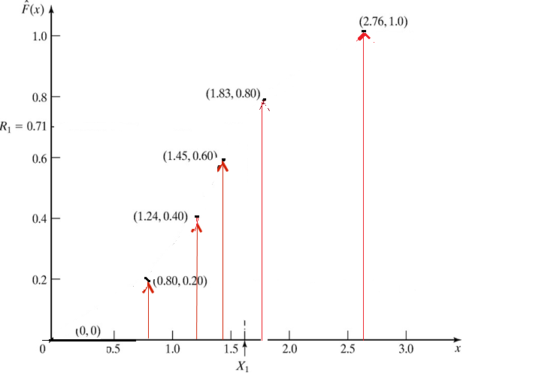
Graph Drawing steps – Identify Points (xi,yi) on graphs

Slide 25
Inverse-transform Technique: Empirical Continuous Distributions
What happens for large samples of data
Several hundreds or tens of thousand
First summarize the data into a frequency distribution with smaller number of intervals
Afterwards, fit continuous empirical CDF to the frequency distribution
Slight modifications
Slope
c_{i} cumulative probability of the first i intervals
a =
^{x}(i ) ^{− x}(i−1)
i
^{c}i ^{− c}i−1
The inverse CDF is given by
X = F^{ˆ −1} (R) = x
a (R − c
) when
c_{i−1} < R ≤ c_{i}
(i−1)
i
i−1

Slide 26
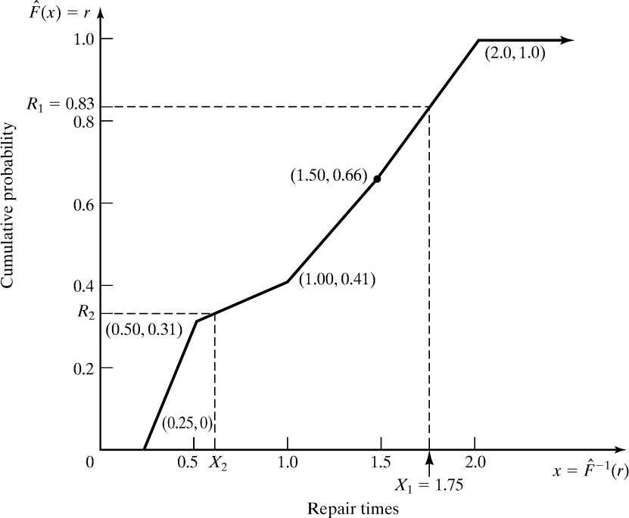
Inverse-transform Technique: Empirical Continuous Distributions
Example: Suppose the data collected for 100 broken-widget repair times are:
Interval (Hours) |  | Frequency | Relative Frequency | Cumulative Frequency, c _{i} | Slope, a _{i}
0.25 ≤ x | ≤ 0.5 | 31 | 0.31 | 0.31 | 0.81
0.5 ≤ x | ≤ 1.0 | 10 | 0.10 | 0.41 | 5.00
1.0 ≤ x | ≤ 1.5 | 25 | 0.25 | 0.66 | 2.00
1.5 ≤ x | ≤ 2.0 | 34 | 0.34 | 1.00 | 1.47
Consider R₁ = 0.83:
c₃ = 0.66 < R₁ < c₄ = 1.00
^{X}1 ^{= x}(4-1) ^{+ a}4^{(R}1 ^{– c}(4-1)⁾
= 1.5 + 1.47(0.83-0.66)
= 1.75

Slide 27
Inverse-transform Technique: Empirical Continuous Distributions
Problems with empirical distributions
The data in the previous example is restricted in the range
0.25 ≤ X ≤ 2.0
The underlying distribution might have a wider range
Thus, try to find a theoretical distribution
Hints for building empirical distributions based on frequency tables
It is recommended to use relatively short intervals
Number of bins increase
This will result in a more accurate estimate

Slide 28
Inverse-transform Technique: Continuous Distributions
A number of continuous distributions do not have a closed form expression for their CDF, e.g.
Normal
Gamma
Beta
x
exp(− ( ) )dt
F (x) =
∫ σ 2π
−∞
t −μ
2
1
1
2 σ
The presented method does not work for these distributions
Solution
Approximate the CDF or numerically integrate the CDF
Problem
Computationally slow

Slide 29
Inverse-transform Technique: Discrete Distribution
All discrete distributions can be generated via inverse- transform technique
Method: numerically, table-lookup procedure, algebraically, or a formula
Examples of application:
Empirical
Discrete uniform
Geometric

Slide 30
Inverse-transform Technique: Discrete Distribution
Example: Suppose the number of shipments, x, on the loading dock of a company is either 0, 1, or 2
Data - Probability distribution:
x | P(x) | F(x)
0 | 0.50 | 0.50
1 | 0.30 | 0.80
2 | 0.20 | 1.00
The inverse-transform technique as table-lookup procedure
F(x_{i−1} ) = r_{i−1} < R ≤ r_{i} = F(x_{i} )
Set X = x_{i}

Slide 31
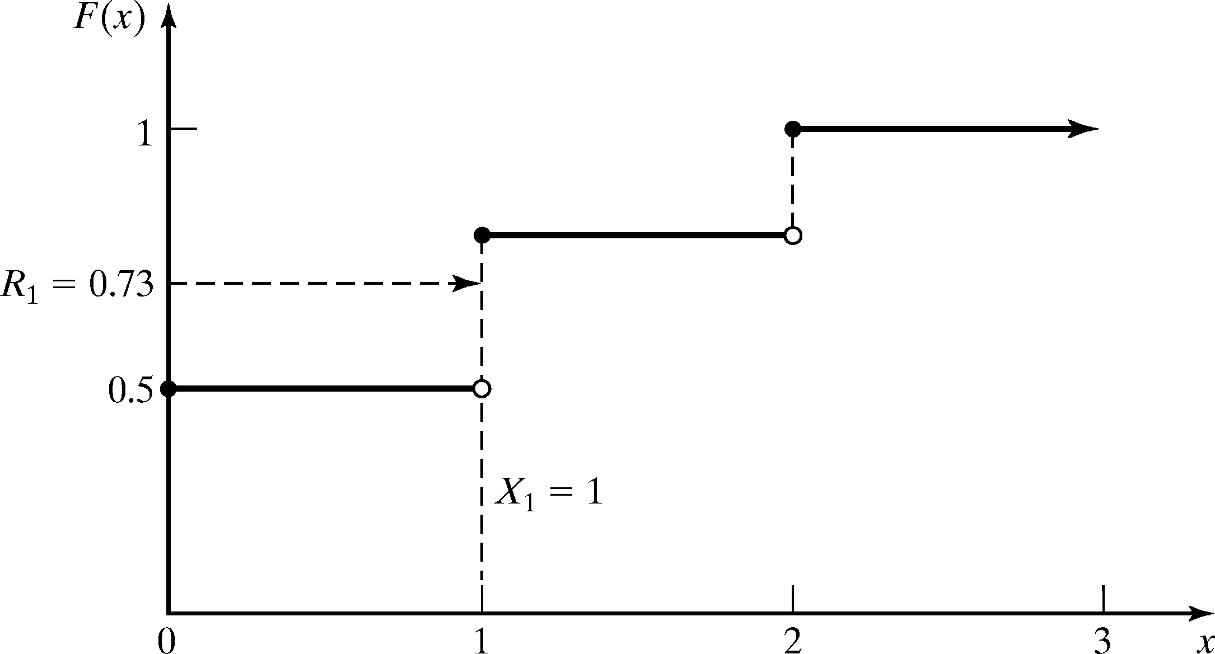
Inverse-transform Technique: Discrete Distribution
Method - Given R, the generation scheme becomes:
0.8
⎧0, R ≤ 0.5 0.5 < R ≤ 0.8
⎮2, 0.8 < R ≤ 1.0
x = ⎮1,
⎨
⎩
Table for generating the discrete variate X
Consider R₁ = 0.73:
F(x_{i-1}) < R ≤ F(x_{i})
F(x₀) < 0.73 ≤ F(x₁)
Hence, X₁ = 1
i | Input r_{i} | Output x_{i}
1 | 0.5 | 0
2 | 0.8 | 1
3 | 1.0 | 2

Slide 32
Acceptance-Rejection Technique

Slide 33













Acceptance-Rejection Technique
Useful particularly when inverse CDF does not exist in closed form
Thinning
Illustration: To generate random variates, X ~ U(1/4,1)
Generate R
Procedure:
Step 1. Generate R ~ U(0,1)
Step 2. If R ≥ ¼, accept X=R.
Step 3. If R < ¼, reject R, return to Step 1
no
Condition
yes
Output R’
R does not have the desired distribution, but R conditioned (R’) on the event {R ≥ ¼} does.
Efficiency: Depends heavily on the ability to minimize the number of rejections.

Slide 34
Acceptance-Rejection Technique: Poisson Distribution
Probability mass function of a Poisson Distribution
_{α}n
P(N = n) =
_{e}−α
n!
Exactly n arrivals during one time unit
A₁ + A₂ +☹+ A_{n} ≤ 1 < A₁ + A₂ +☹+ A_{n} + A_{n+1}
Since interarrival times are exponentially distributed we can set
ln(R )
A =
i
i
α
Well known, we derived this generator in the beginning of the class

Slide 35
Acceptance-Rejection Technique: Poisson Distribution
Substitute the sum by
n
ln(R_{i} ) − ln(R_{i} )
n+1
∑
≤ 1 < ∑
α α
i=1 i=1
Simplify by
multiply by -α, which reverses the inequality sign
sum of logs is the log of a product
n n+1
∑ln(R_{i} ) ≥ −α > ∑ln(R_{i} )
i=1
i=1
n+1
n
ln∏ R_{i} ≥ −α > ln∏ R_{i}
i=1
i=1
Simplify by e^{ln(x)} = x
n
n+1
∏ i
R ≥ e > ∏ R
−α
i
i=1
i=1

Slide 36
Acceptance-Rejection Technique: Poisson Distribution
Procedure of generating a Poisson random variate N is as follows
Set n=0, P=1
Generate a random number R_{n+1}, and replace P by P x R_{n+1}
If P < exp(-α), then accept N=n
Otherwise, reject the current n, increase n by one, and return to step 2.

Slide 37
Acceptance-Rejection Technique: Poisson Distribution
Example: Generate three Poisson variates with mean α=0.2
exp(-0.2) = 0.8187
Variate 1
Step 1: Set n = 0, P = 1
Step 2: R1 = 0.4357, P = 1 x 0.4357
Step 3: Since P = 0.4357 < exp(- 0.2), accept N = 0
Variate 2
Step 1: Set n = 0, P = 1
Step 2: R1 = 0.4146, P = 1 x 0.4146
Step 3: Since P = 0.4146 < exp(-0.2), accept N = 0
Variate 3
Step 1: Set n = 0, P = 1
Step 2: R1 = 0.8353, P = 1 x 0.8353
Step 3: Since P = 0.8353 > exp(-0.2), reject n = 0 and return to Step 2 with n = 1
Step 2: R2 = 0.9952, P = 0.8353 x 0.9952 = 0.8313
Step 3: Since P = 0.8313 > exp(-0.2), reject n = 1 and return to Step 2 with n = 2
Step 2: R3 = 0.8004, P = 0.8313 x 0.8004 = 0.6654
Step 3: Since P = 0.6654 < exp(-0.2), accept N = 2

Slide 38
Acceptance-Rejection Technique: Poisson Distribution
It took five random numbers to generate three Poisson variates
In long run, the generation of Poisson variates requires some overhead!
N | ^{R}n+1 | P | Accept/Reject |  | Result
0 | 0.4357 | 0.4357 | P < exp(- α) | Accept | N=0
0 | 0.4146 | 0.4146 | P < exp(- α) | Accept | N=0
0 | 0.8353 | 0.8353 | P ≥ exp(- α) | Reject
1 | 0.9952 | 0.8313 | P ≥ exp(- α) | Reject
2 | 0.8004 | 0.6654 | P < exp(- α) | Accept | N=2

